Slide 1
Target Product Profiles
An Essential Tool in Development and Strategic Management of New or Modified Drugs/Biologics/Devices
Anastassios D. Retzios, Ph.D.

Slide 2
What is a Target Product Profile?
A Target Product Profile (TPP) is a summary of the drug development program described in terms of labeling concepts
It is prepared by the all departments of the company involved in the development of the therapeutic or diagnostic agent
Its submission to the FDA is voluntary but has specific benefits*
The TPP is a “living document” evolving and maturing with increasing knowledge and experience
* The FDA has recently withdrawn its draft guidance on TPPs. However, elements of the TPP, basic principles and subcomponents such as the Quality TPP (QTPP) are still included in guidances on Quality by Design (QbD)

Slide 3
TTPs and the Pharmaceutical Industry
Detailed TPPs have a key role in the pharmaceutical industry in Strategic Program Management (SPM)*
TPPs explore various labeling scenarios
  Target, Minimal, Optimal
TPPs estimate (for each scenario)
  Probabilities of Success
  Development Costs
  Personnel
  Manufacturing
  Market Penetration / Competitors
* Strategic Program Management is a series of practices and procedures, which characterize the extent to which an organization creates effective linkages between excellent project management practices and excellent business practices
Heerkens, G. (2007). Introducing the revolutionary strategic project management maturity model (SPM3)- PMI® Global Congress

Slide 4
TPP and Quality by Design (QdD)
Quality by Design (QdB) is a development methodology based on detailed scientific understanding of the test therapeutic agent (its properties and manufacturing process), has predefined objectives and employs effective controls and risk management
Quality by Design principles are included in the ICH guidances Q8, Q9 and Q10
These guidances deal mostly with the quality and risk management of the drug/biologic product. As such, there are provisions therein that address the Quality Target Product Profile (QTTP), an essential subcomponent of the TTP
ICH and FDA are currently extending key elements of QbD to clinical trials.
  Draft guideline E8(R1): General Considerations for Clinical Trials, May 2019

Slide 5
Assembly of an Industry TPP
A common template should be used for all products, bringing consistency to the process
A TPP is assembled for each product entering development and each new indication for an existing drug/biologic
Input is elicited from various departments. Assembling a TPP is a team effort
The owner of the TPP is usually the Project Manager who coordinates the activities of specific product development team
The TPP constitutes an important evaluation tool in “gate reviews”, if such reviews are enabled by the organization

Slide 6
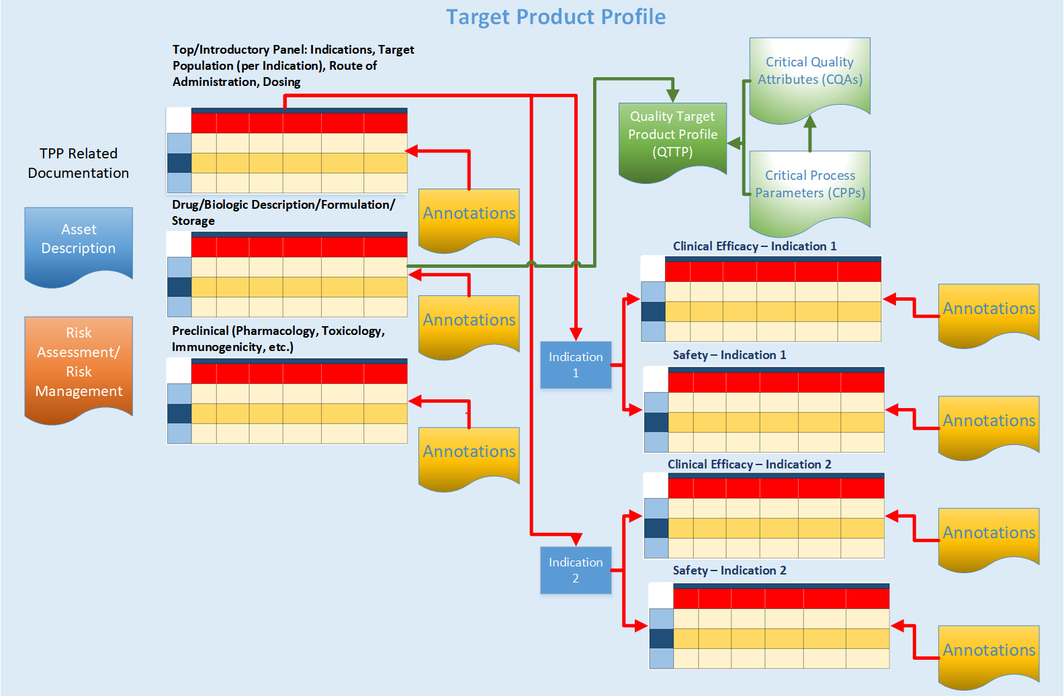
Components of a TPP
Elements and utilization of QTTP are covered by the ICH Q8 Guidance
Annotations must be detailed and properly documented to provide a comprehensive explanation for the choices made in the TPP

Slide 7
TPP General Statement
Project Name | (Name)
Project Description | Summary description of the product
Project Category | Is the project is an additional indication for an existing drug or a new project?
Strategic Fit and Value | How well does this drug/biologic fit with the core expertise and capabilities of the company?
Value to Patients | What is the specific value of this drug/biologic to patients? Does it offer therapeutic, safety or ease of use advantages over existing or upcoming drugs/biologics
Company’s competitive position | Does the company have a competitive advantage?
Company’s IP position | Brief summary of the IP position regarding this drug
Rationale for success | Brief summary as to why the developing team believes that this product would
Factors for success | Brief statement as to the company’s core competencies and market conditions that would drive a successful outcome
Key risk factors | Brief statement identifying possible risks
Consequences for not pursuing the project | What would happen if this project is not pursued?
Possible alternatives to this project | Are there any alternatives to this project?

Slide 8
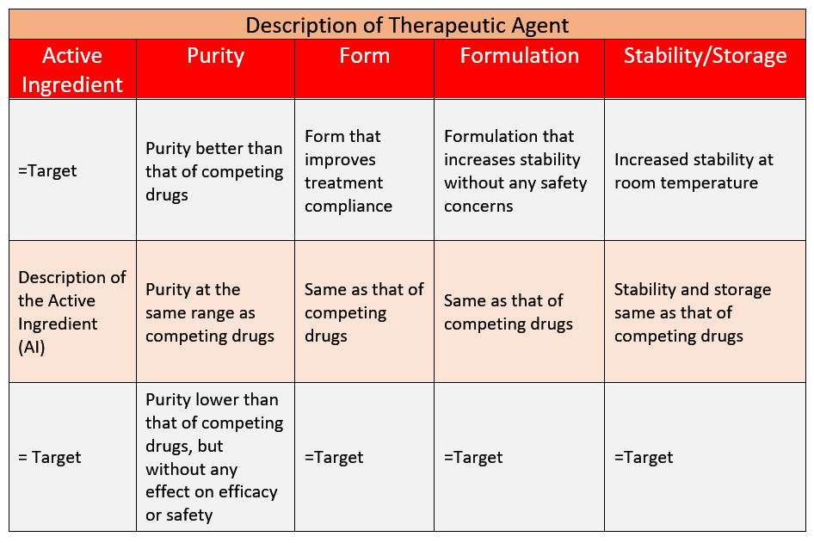
TPP Description of Therapeutic Agent
This particular TPP module can be substituted by the QTTP, if desired.
The QTTP will provide more information on certain parameters of the new drug (see slide 11)
Optimistic
Target
Minimal
The above panel presupposes that the new agent belongs to the same compound class as preexisting or competing treatments
If not, or if it is a drug in an indication previously served by biologics (or vice versa), then it needs to be redesigned accordingly
Additional properties, such as the identity and concentration of contaminants or the utilization of any particular delivery devices, may be added to this description

Slide 9
TPP Summary of Efficacy
Primary Indication
Primary Clinical Endpoint (s) |  | Target Patient Population | Route of Administration | Treatment Regimen
Clinical Outcome 1 | Clinical Outcome 2
Meets the primary and a number of secondary endpoints that may result in claims | >Target Or =Target | >Target Or =Target | >Target (if more than the target routes are tested) Or =Target | > Lower doses and/or less frequent administration may provide advantages
Meets the primary endpoint(s) of the pivotal study (or studies) | Provide entries if more than one primary endpoint | Target (Describe target population) | Target (Describe target route(s) of administration) | Target (Describe target regimen)
= Target | = Target (if essential for regulatory success) | =Target Or <Target If successful in a more limited population | = Target Or < Target If the least desirable tested route is successful | > Higher dosing and more frequent administration than target that may still be acceptable
Optimistic
Target
Minimal

Slide 10
TPP Summary of Safety
Primary Indication
Safety |  | Drug Interactions | Precautions | Contra-indications
Clinical | Non-Clinical
>Target if fewer and less severe AE profile Or =Target |  | >Target if fewer and less severe interactions Or =Target | >Target if no or fewer precautions Or =Target | >Target if no or fewer contraindications Or =Target
Target safety is usually equivalent to the known safety of the same class or similar classes of compounds that have been approved | Laboratory or other findings similar to those observed for the same class or similar classes of compounds that have been approved | Interactions similar to those observed for the same class or similar classes of compounds that have been approved | Precautions similar to those observed for the same class or similar classes of compounds that have been approved | Contraindications similar to those observed for the same class or similar classes of compounds that have been approved
= Target (<Target would be acceptable if risk/benefit ratio is favorable) | = Target (<Target would be acceptable if risk/benefit ratio is favorable) | =Target (<Target acceptability criteria should be explained) | = Target (<Target acceptability criteria should be explained) | = Target (<Target acceptability criteria should be explained)
Optimistic
Target
Minimal

Slide 11
Additional Elements of TPP
The TPP may contain additional elements regarding:
  Product design and formulation
    Contaminants
    Any delivery system associated with the drug
  Projected dates of submissions, regulatory approval and launch
  Cost of goods, pricing, market size
  Target, optimistic and minimal conditions may be set for these elements

Slide 12
How to Assemble a TPP
Utilize the following:
  Define properties of the drug in preclinical development
    Pharmacokinetics
    Toxicology
    Efficacy in animal models
  Select target indication(s)
    Structure a TPP for each indication that may require additional development
  Examine approved claims of competitors (efficacy and safety)
  Examine the competitive environment for compounds currently in development and likely to be approved in the near future
  Elaborate on minimal and optimal profiles

Slide 13
TPP as a Strategic Planning Tool
Clinical Development
  TPP scenarios can be used for:
    Design of clinical studies
    Design of detailed timelines
    Evaluation of risks and creation of mitigation plans
    Estimation of the possibility of success
    Estimate budgets/personnel
Regulatory /Clinical
  Estimation of likely approval dates in various geographies
Manufacturing
  Evaluation of manufacturing options/expenditure
Marketing
  Estimation of costs of goods
  Estimation of pricing
  Estimation of marketing campaign costs
  Estimation market penetration (focus groups)

Slide 14
Utilizing TPPs in Development
TPPs utilized correctly can:
  Assess risks and create risk mitigation plans for all stages of clinical development
  Assign a probability of success at each phase of clinical development and each indication targeted
    Assumptions of probability of success at any stage of development should be explained and contrasted to industry norms
  Promote a team-based approach
    Compiling TPPs is a team-based activity that enhances collaboration among project team members and increases awareness of the project’s critical issues throughout the organization

Slide 15
Risk Identification and Mitigation Plan (Clinical Development)
Risk # | Risk | Impact (1 to 5) | Risk of Occurrence (1-5) | Mitigation Action Plan | Ownership (Enter Appropriate Department) | Date for Action
1 | Phase 1 study (Describe Risk) | 1= minimal impact 5 = maximal impact | 1= unlikely 2= possible 3= probable 4= likely 5= very likely | Enter mitigation plan (Note if the occurrence of the outlined risk leads to program discontinuation)
2 | Phase 2 study: (Describe Risk) | 1= minimal impact 5 = maximal impact | 1= unlikely 2= possible 3= probable 4= likely 5= very likely | Enter mitigation plan (Note if the occurrence of the outlined risk leads to program discontinuation)
3 | Phase 3a study (Describe Risk) | 1= minimal impact 5 = maximal impact | 1= unlikely 2= possible 3= probable 4= likely 5= very likely | Enter mitigation plan (Note if the occurrence of the outlined risk leads to program discontinuation)
4 | Phase 3b study (Describe Risk) | 1= minimal impact 5 = maximal impact | 1= unlikely 2= possible 3= probable 4= likely 5= very likely | Enter mitigation plan (Note if the occurrence of the outlined risk leads to program discontinuation)
5 | Regulatory | 1= minimal impact 5 = maximal impact | 1= unlikely 2= possible 3= probable 4= likely 5= very likely | Enter mitigation plan (Note if the occurrence of the outlined risk leads to program discontinuation)

Slide 16
Example of Development Plan
Risk Tree Analysis based on TPP
Candidate
Development
Preclinical
Phase I
Phase II
Phase III
Regulatory
Path
Probability
Optimistic
Success
P =
Target
TBD
P = 0.9
P = 1.0
Success
Minimal
Success
P = 0.7
Failure
P =
TBD
Success
P = 0.7
Stop
TBD
Success
P = 0.7
Stop
TBD
Success
P = 0.76
Stop
TBD
P = 0.95
Stop
TBD
Stop
TBD
SUM

Slide 17
Summary
TPPs are excellent tools for:
  Planning the development of a novel agent
  Obtaining accurate and helpful feedback from regulatory agencies
  Estimating the project risks
  Evaluating the possibility of success
    Comparing possibilities of success of other product configurations and indications
  Evaluating the total costs of development
  Estimating the market opportunity
  Retaining focus throughout the development process

